Slide 1






Streamlining Customer Feedback: The Online Complaint Registration System
⥫
Team members:
S.G.Kaviya Jancy.A Swathikasri.S Divya Dharshini.S

Slide 2








The Online Complaint Registration and Management System is a centralized platform for handling complaints, utilizing React, Express, MongoDB, and Node.js environments. It utilizes REST APIs like Postman API for efﬁcient handling. Key functionalities include automated notiﬁcations, intelligent complaint routing, and robust security measures, enhancing operational workftows, customer satisfaction, and compliance with industry regulations.

Slide 3








Complaint management is crucial for organizations to uphold customer satisfaction and reputation. The Online Complaint Registration and Management System simpliﬁes the process, empowering users to report issues and interact with agents. It enhances operational efﬁciency, ensures compliance with regulations, and fosters transparency, accountability, and improved service quality

Slide 4


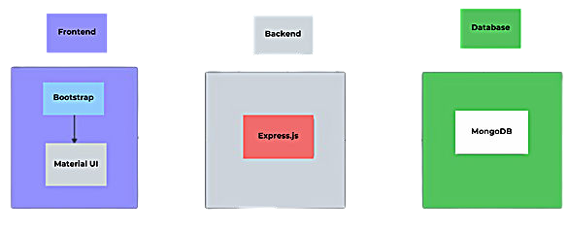
⥫

Slide 5






The System streamlines complaint handling
features
through a centralized platform. Key include:
Real-Time Tracking: Enables instant monitoring of complaint status.
Automated Notiﬁcations: Keeps users updated on progress and resolutions.
Intelligent Routing: Directs
complaints to appropriate agents based on set criteria.
Enhanced Security: Protects user data and ensures compliance.

Slide 6






The system's frontend, built with React, offers a user-friendly interface with features like complaint submission, status tracking, and admin dashboard. It includes real-time validation, responsive design, and instant updates through efﬁcient state management. React’s API integration ensures seamless data ftow with the backend.

Slide 7



The backend, powered by Express, Node.js, and MongoDB,
efﬁcient, non-blocking processes, and MongoDB stores complaint data securely. RESTful APIs enable smooth interaction, making the system reliable and responsive.
supports | complaint handling, user | registration, and | status
updates. | Express manages routing, | Node.js allows

Slide 8







To manage user requests like complaint registration, status tracking, and user administration, the React-built frontend communicates with the backend.
Express.js acts as the server framework,
controlling the API routes that allow data to ftow between the database and the client. While MongoDB stores and gets complaint data in real-time, the Node.js backend handles these queries asynchronously to ensure effective and non-blocking data ftow.
Postman was used for API testing to verify that all RESTful endpoints for creating, reading, amending, and removing complaints
operate as intended, ensuring a seamless integration.

Slide 9


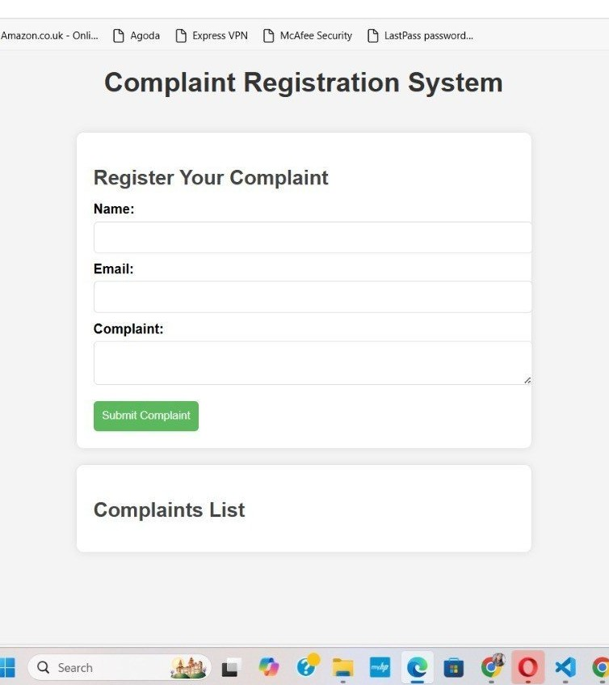
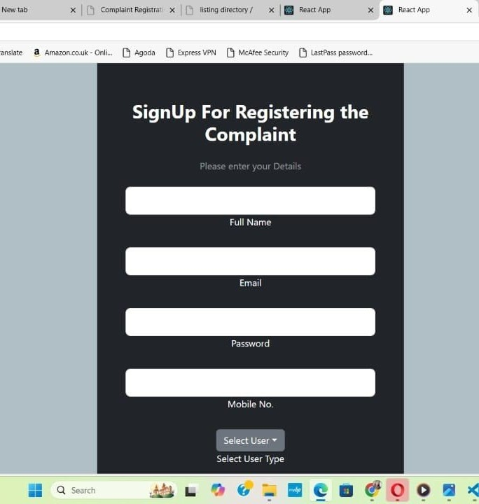

Slide 10





The Online Complaint Registration and Management System is a signiﬁcant advancement in handling complaints, promoting transparency and efﬁciency. It provides a user-friendly platform for resolving complaints, ensuring regulatory compliance and protecting sensitive data. Future enhancements will enhance the
system's | capabilities, | fostering | continuous | improvement | and
customer | satisfaction.

